Slide 1

Data Analysis of FIFA 2021-MoneyBall
Neda Khatami
March 2023

Slide 2

- FIFA 21 is an association football simulation video game.
- The datasets provided include the players data for the Career Mode from FIFA 15 to FIFA 21.
- The dataset includes 107 features and 17125 rows!
Introduction and Challenges
Introduction
Alginate/collagen/nano-Silica, Alginate/gelatin/nano-Silica, Alginate/nano-Silica (control)
mechanical strength, swelling ratio, biodegradation, and SEM analyses
Challenges
Perform an end-to-end analysis to analyze this large dataset
Apply statistical or machine learning techniques to assess this dataset
Cell proliferation, calcium deposition, matrix mineralization, and gene expression
1

Slide 3
Introduction and Challenges
Objectives
1- Define Questions
In which clubs do the best players play??
Which clubs have the highest number of the best players among top 20 teams?
2- Predict a Numerical Target
What is the age of the best players??
Alginate/collagen/nano-Silica, Alginate/gelatin/nano-Silica, Alginate/nano-Silica (control)
Objectives
mechanical strength, swelling ratio, biodegradation, and SEM analyses
Cell proliferation, calcium deposition, matrix mineralization, and gene expression
2

Slide 4
Methods
Introduction
Objective 2
Objective 1
Define the numerical target
Define the questions
Objectives
Standardization
EDA
Shape, correlations, plots, histograms
Dropping unnecessary columns
Read and clean the data
Methods
Dealing with null values
Processing Data
Scaling, Normalization, outliers
Answer the questions by exploring the data
Applying linear regression
Predictions
Evaluating the model
R2, RMSE, MSE
4

Slide 5
Objective 1: Which clubs have the best and the highest number of best players?

Slide 6
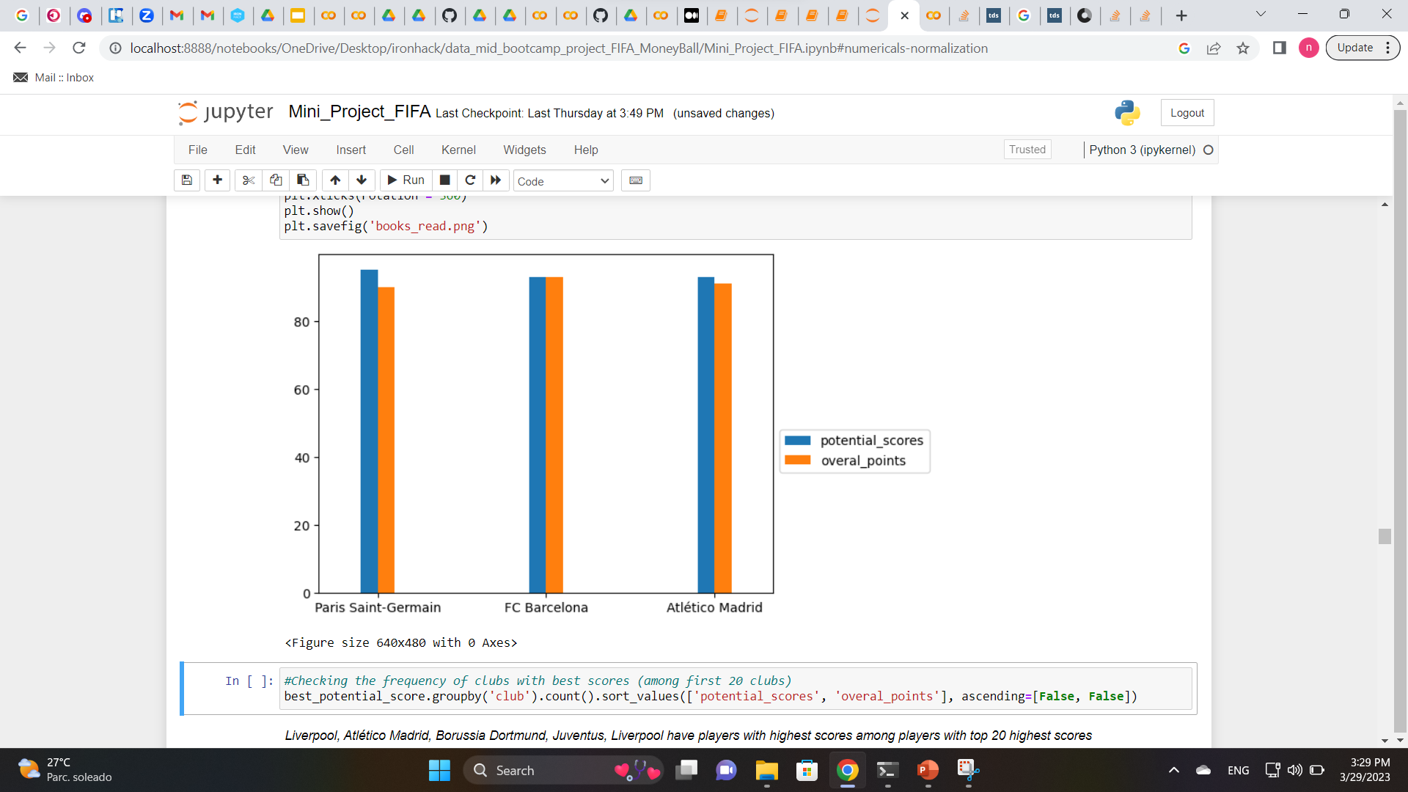
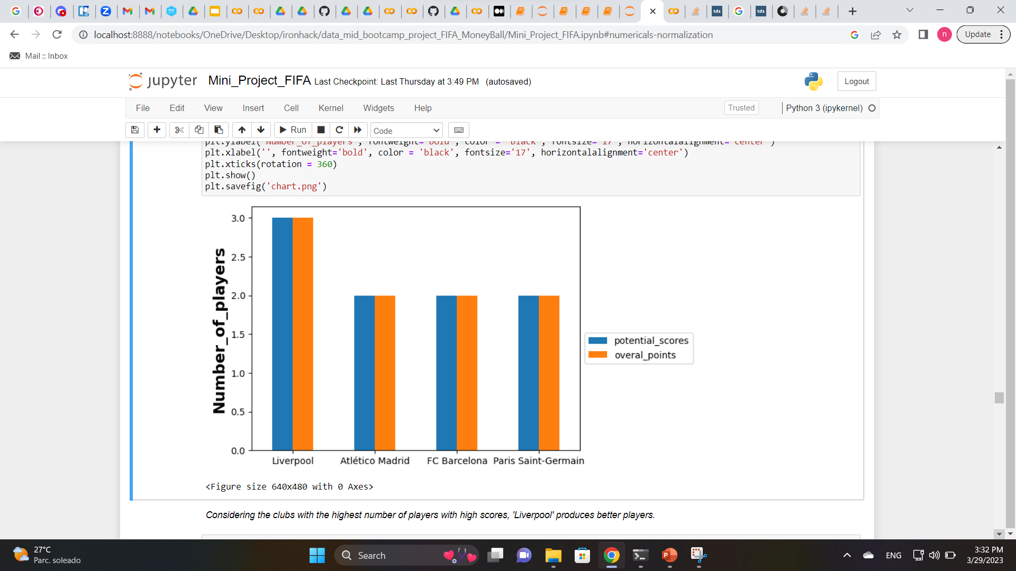
Objective 1
Objective 2
Introduction
Which club has the best and the highest number of players?
Define the numerical target
Define the questions
Objectives
Standardization
Not a big difference!
Top 3 potential_scores of each player
EDA
Shape, correlations, plots, histograms
Dropping unnecessary columns
Read and clean the data
Methods
Dealing with null values
Processing Data
Scaling, Normalization
Answer the questions by exploring the data
Applying linear regression
Results-
Objective 1
Liverpool has the highest number of players with the best potential_scores.
Top 3 clubs with the highest number of potential_scores of each player
Predictions
Evaluating the model
5

Slide 7
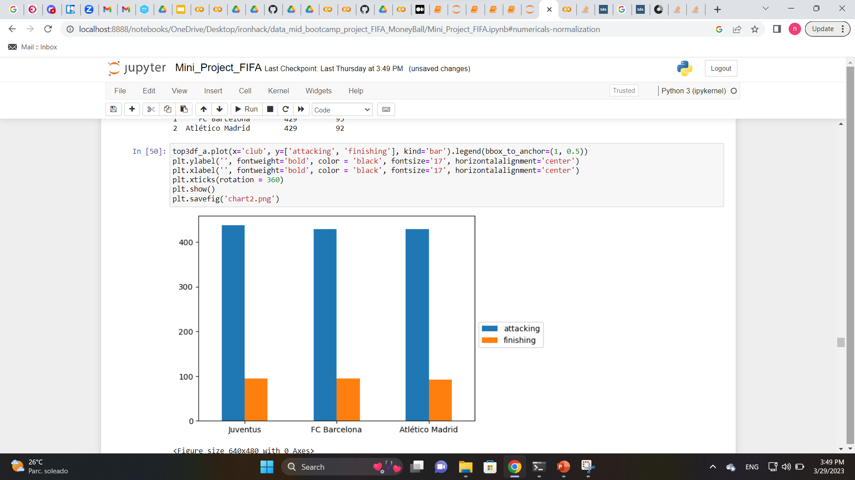
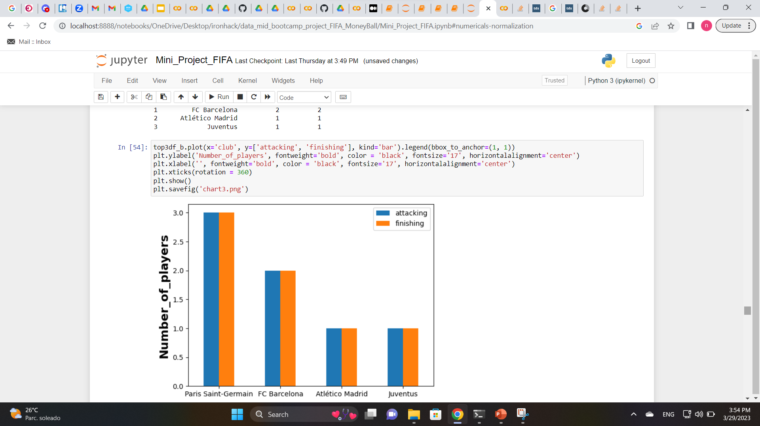
Objective 1
Objective 2
Introduction
Which club has the best and the highest number of players?
Define the numerical target
Define the questions
Not a big difference!
Objectives
Standardization
Top 3 clubs with best players in attacking and finishing
EDA
Shape, correlations, plots, histograms
Dropping unnecessary columns
Read and clean the data
Methods
Dealing with null values
Processing Data
Scaling, Normalization
Answer the questions by exploring the data
Applying linear regression
Paris Saint German and FC Barcelona have the highest number of players with best attacking and finishing
Results-
Objective 1
Top 3 clubs with the highest number of players with best attacking and finishing
Predictions
Evaluating the model
6

Slide 8
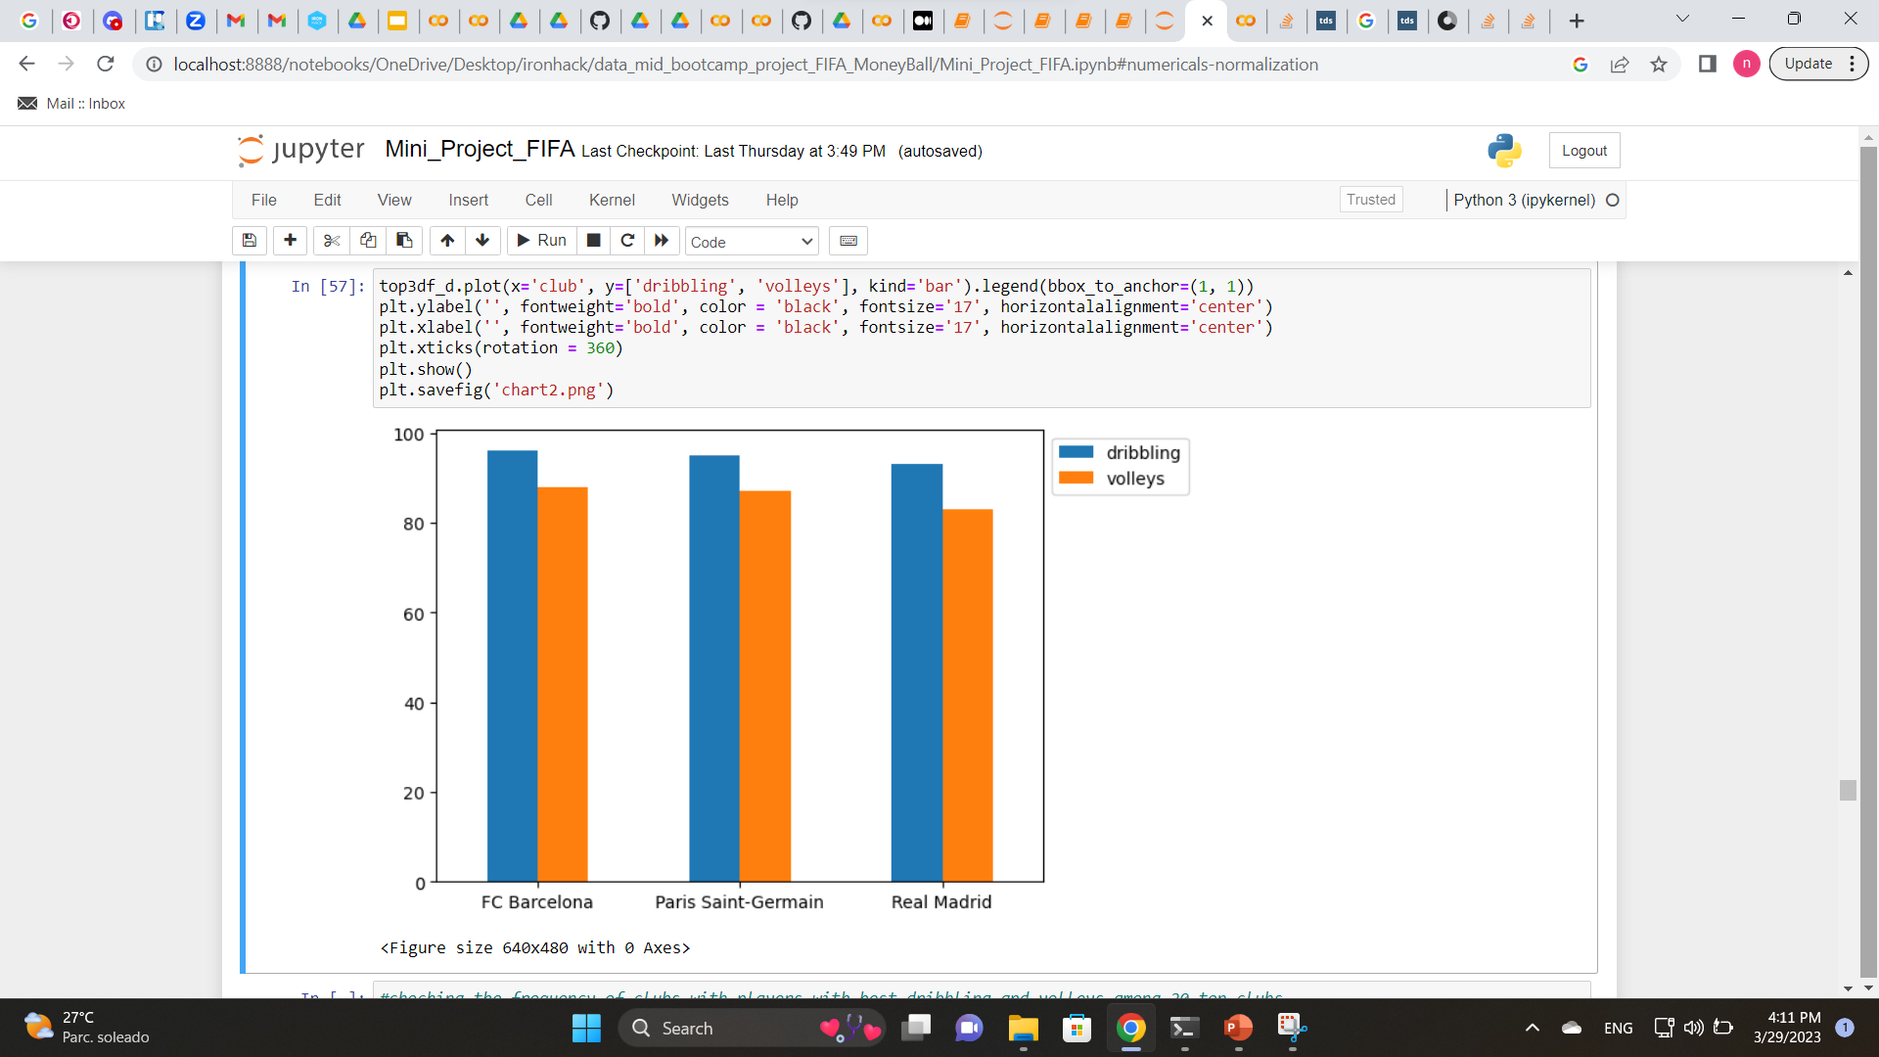
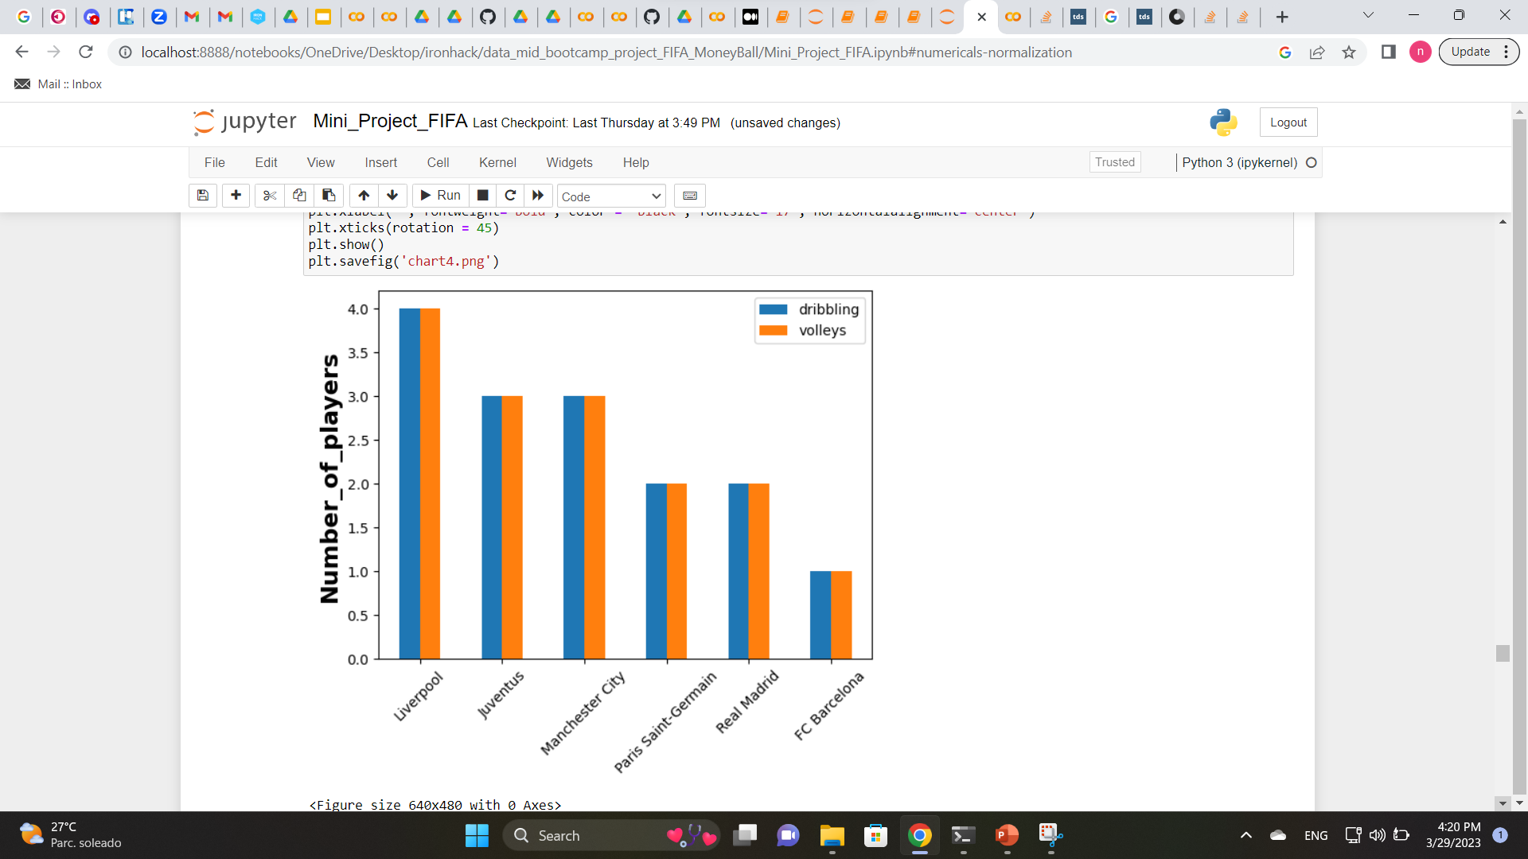
Which club has the best and the highest number of players?
Objective 2
Introduction
Objective 1
Define the numerical target
FC Barcelona, Paris Saint Germain, Real Madrid
Not a big difference among them!
Top 3 clubs with best players in dribbling and volleys
Objectives
Define the questions
Standardization
EDA
Shape, correlations, plots, histograms
Dropping unnecessary columns
Read and clean the data
Methods
Dealing with null values
Processing Data
Scaling, Normalization
Liverpool, Juventus, Manchester City, Paris Sain Germain and Real Madrid have the highest number of players with best dribbling and volleys
Answer the questions by exploring the data
Applying linear regression
Results-
Objective 1
Top 3 clubs with the highest number of players with best dribbling and volleys
Predictions
Evaluating the model
7

Slide 9
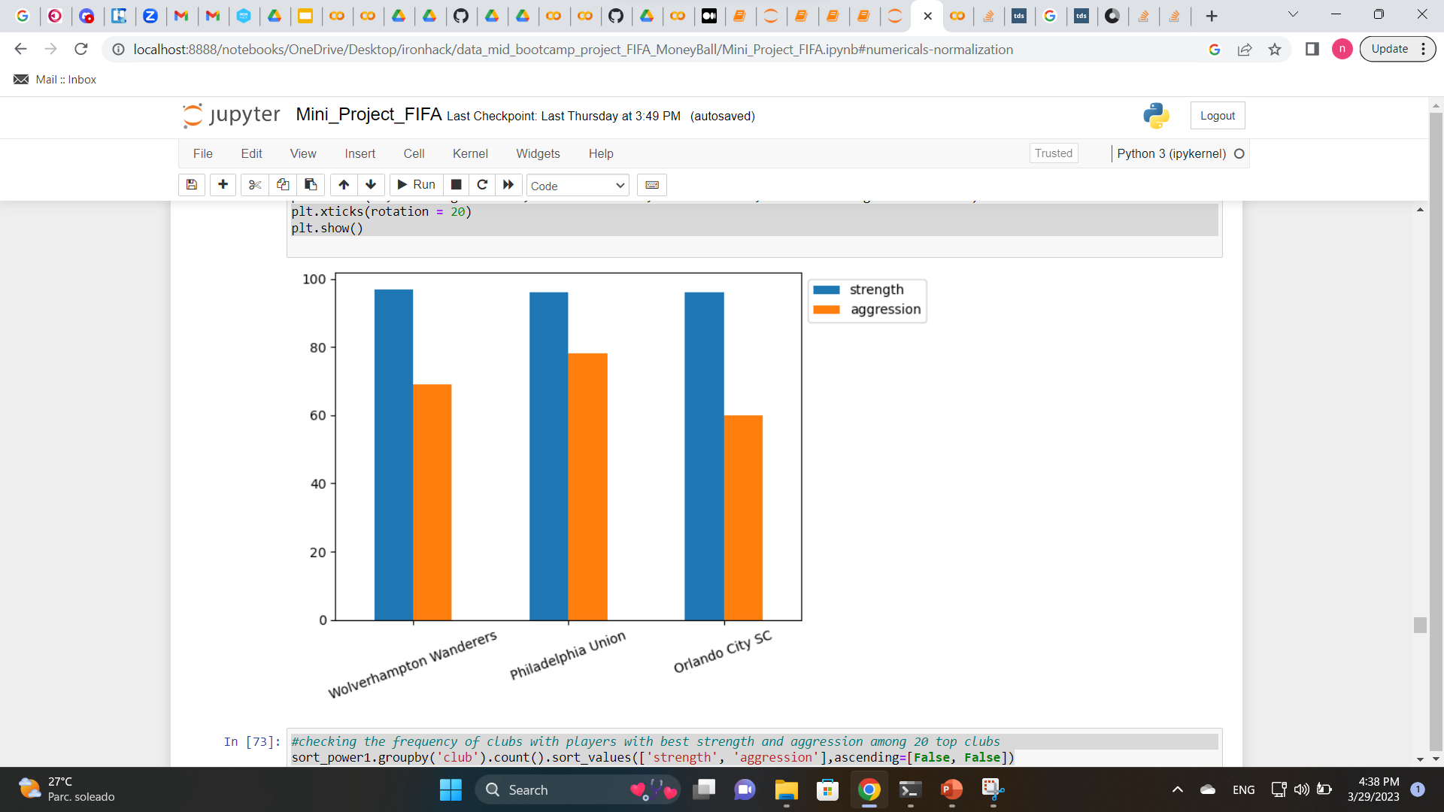
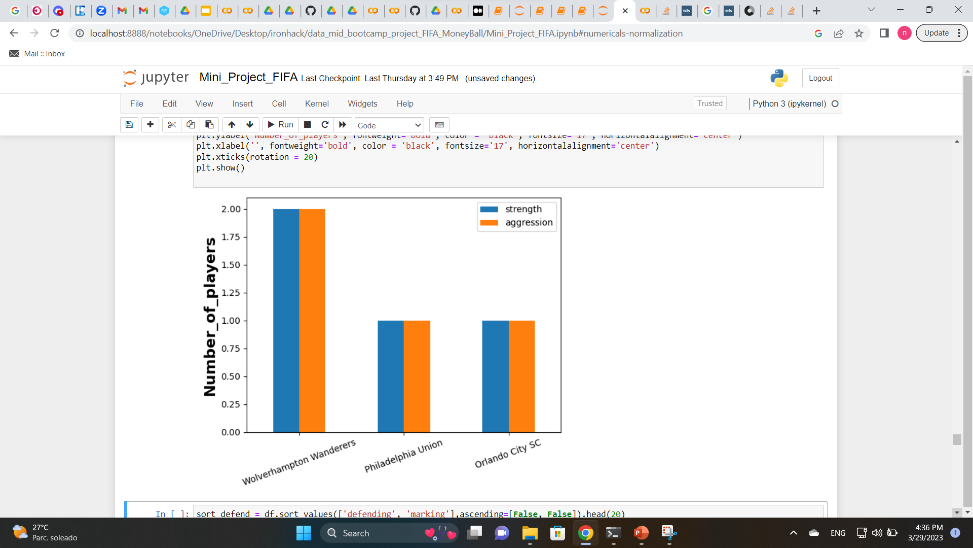
Which club has the best and the highest number of players?
Objective 2
Introduction
Objective 1
Define the numerical target
Wolverhampton, Philadelphia Union, Orlando City SC have the top players in strength and aggression.
Not a big difference among them!
Top 3 clubs with best players in strength and aggression
Objectives
Define the questions
Standardization
EDA
Shape, correlations, plots, histograms
Dropping unnecessary columns
Read and clean the data
Methods
Dealing with null values
Processing Data
Scaling, Normalization
Answer the questions by exploring the data
Top 3 clubs with the highest number of players with best strength and aggression
Applying linear regression
Results-
Objective 1
Wolverhampton, has the highest number of players with best strength and aggression
Predictions
Evaluating the model
9

Slide 10
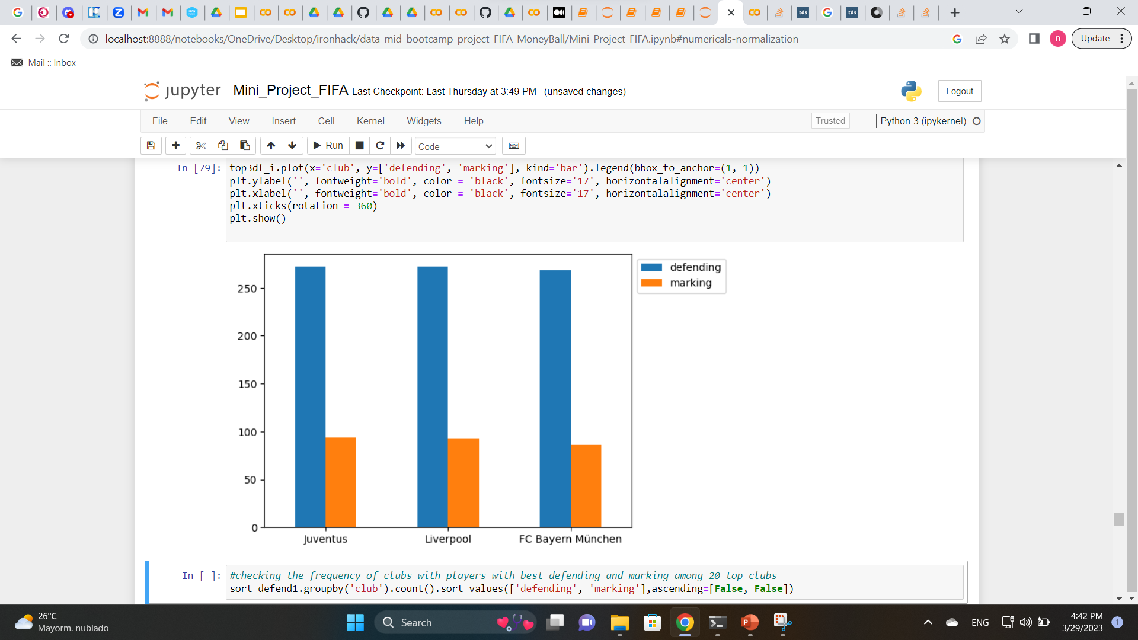
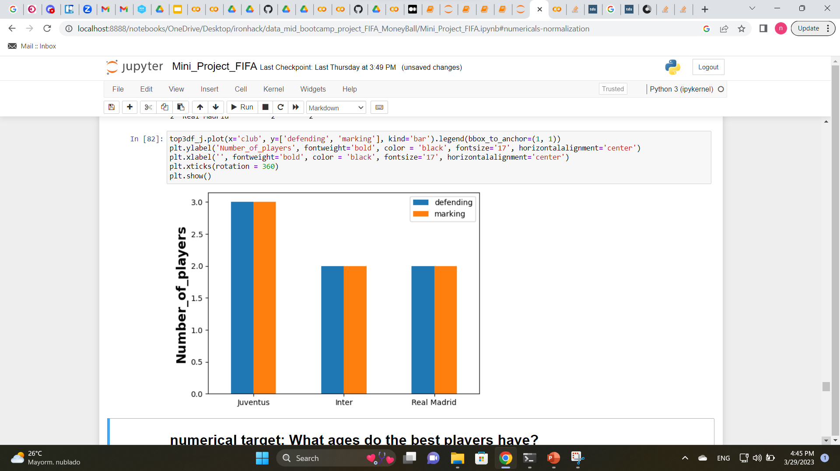
Which club has the best and the highest number of players?
Objective 2
Introduction
Objective 1
Define the numerical target
Juventus, Liverpool, FC Bayern Munchen have the top players in defending and marking.
Not a big difference among them!
Top 3 clubs with best players in defending and marking
Objectives
Define the questions
Standardization
EDA
Shape, correlations, plots, histograms
Dropping unnecessary columns
Read and clean the data
Methods
Dealing with null values
Processing Data
Scaling, Normalization
Answer the questions by exploring the data
Top 3 clubs with the highest number of players with best defending and marking
Applying linear regression
Results-
Objective 1
Juventus, Inter, Real Madrid have the highest number of players with best defending and marking
Predictions
Evaluating the model
10

Slide 11
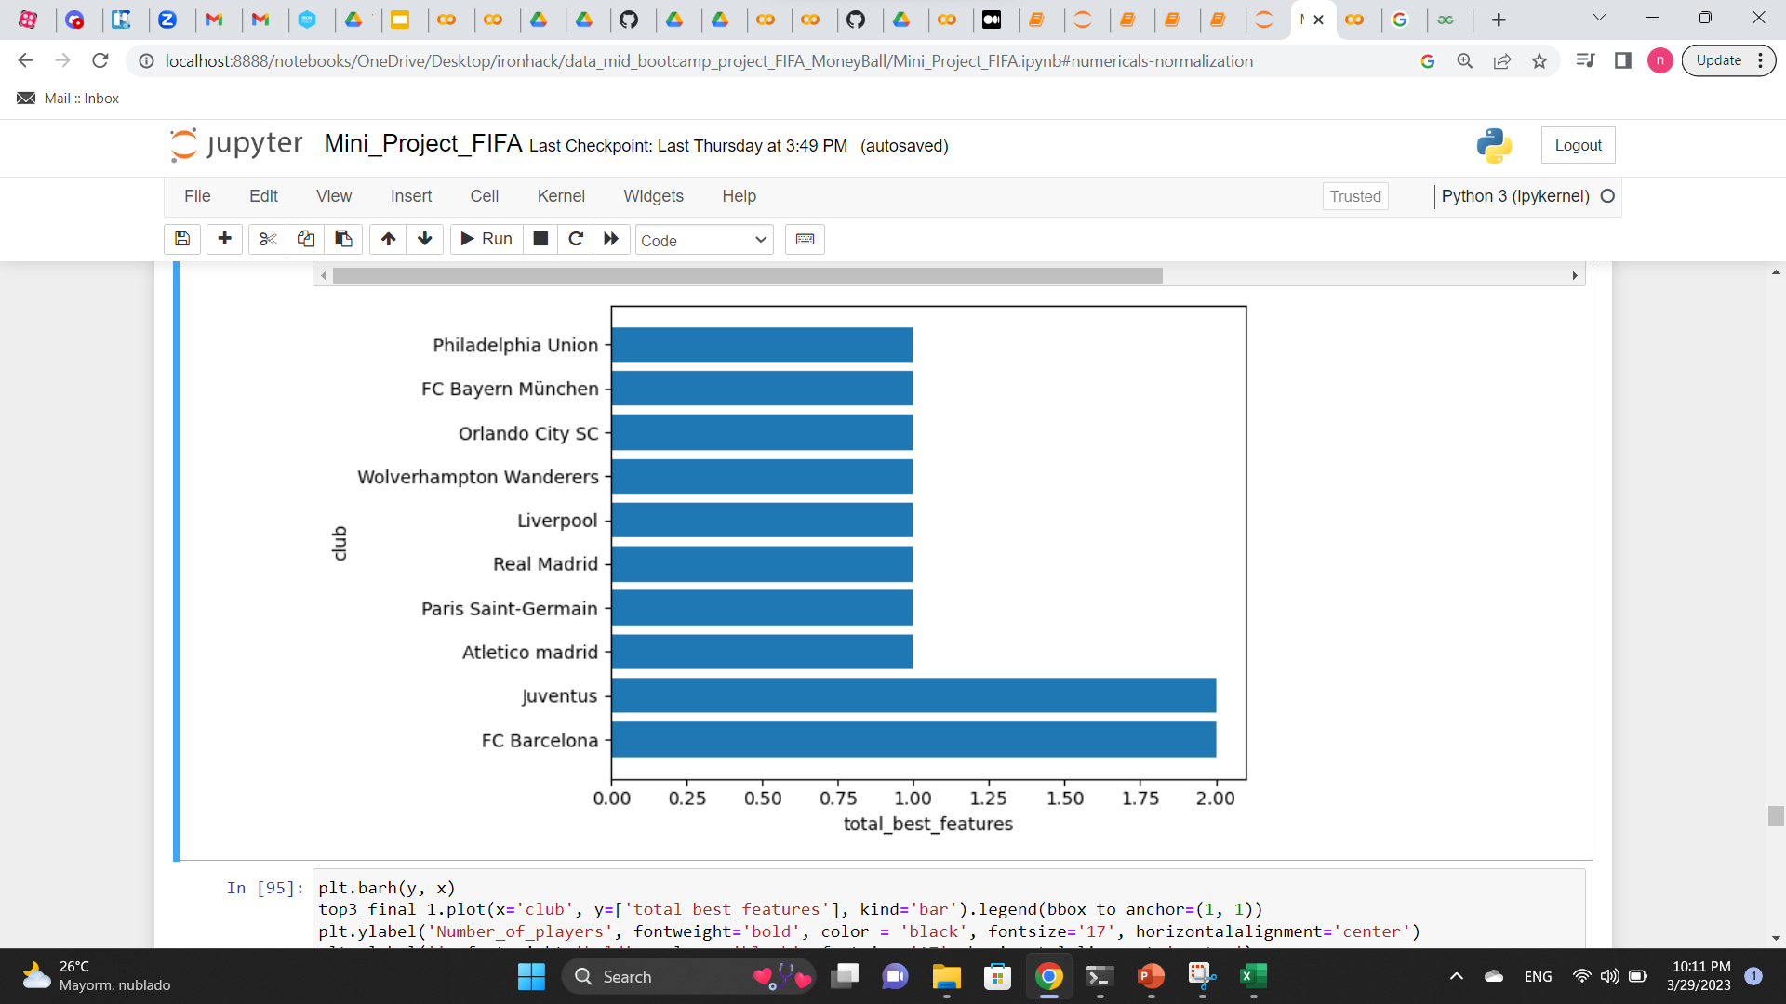
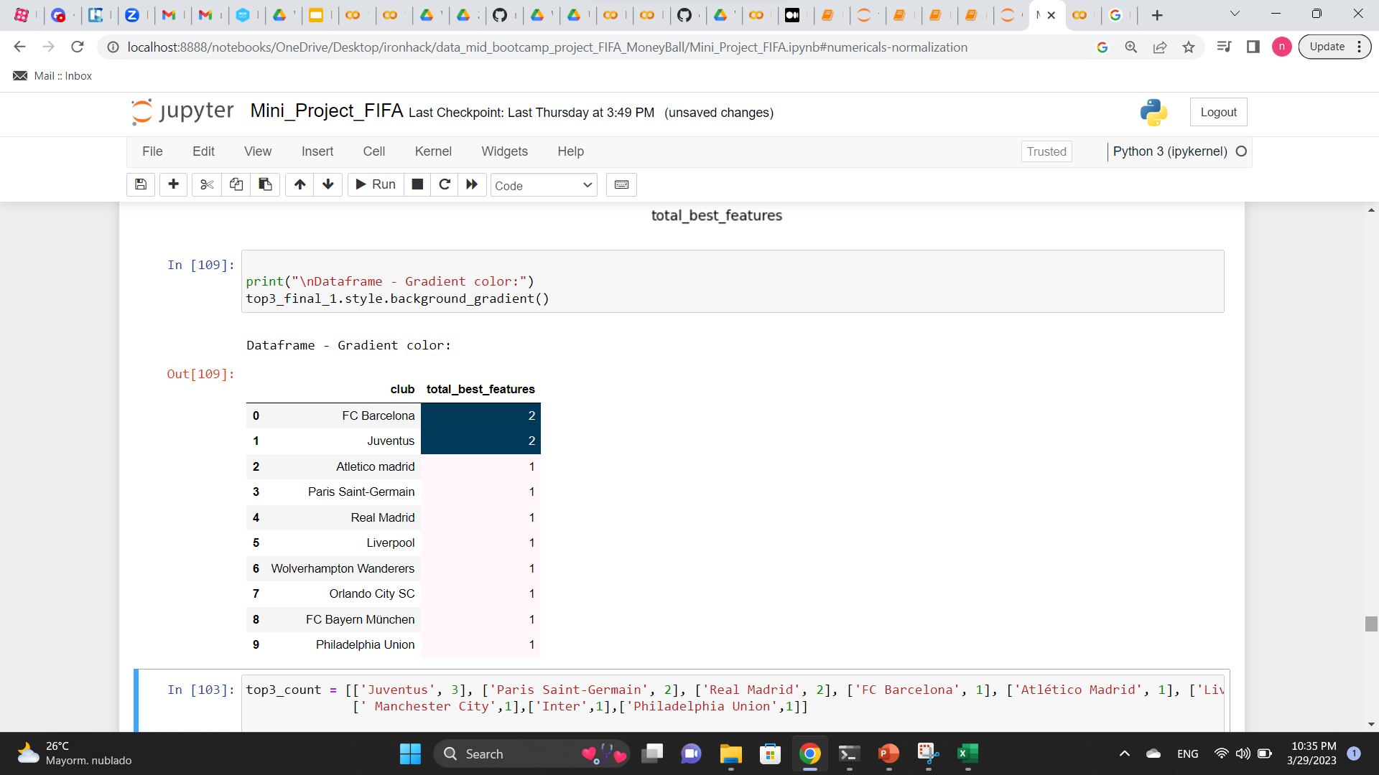
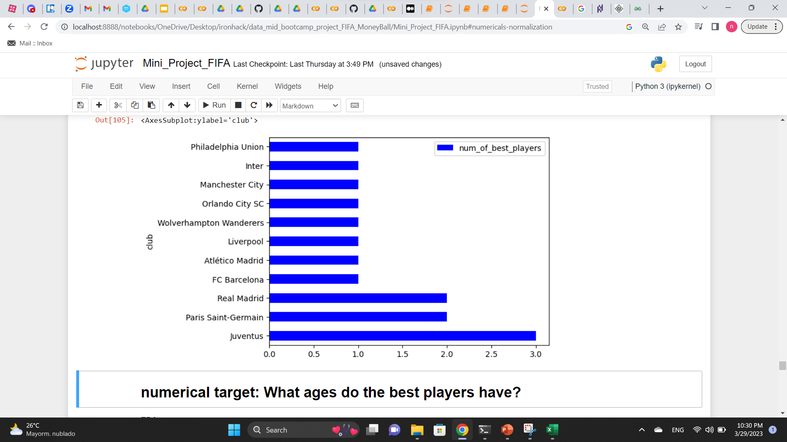
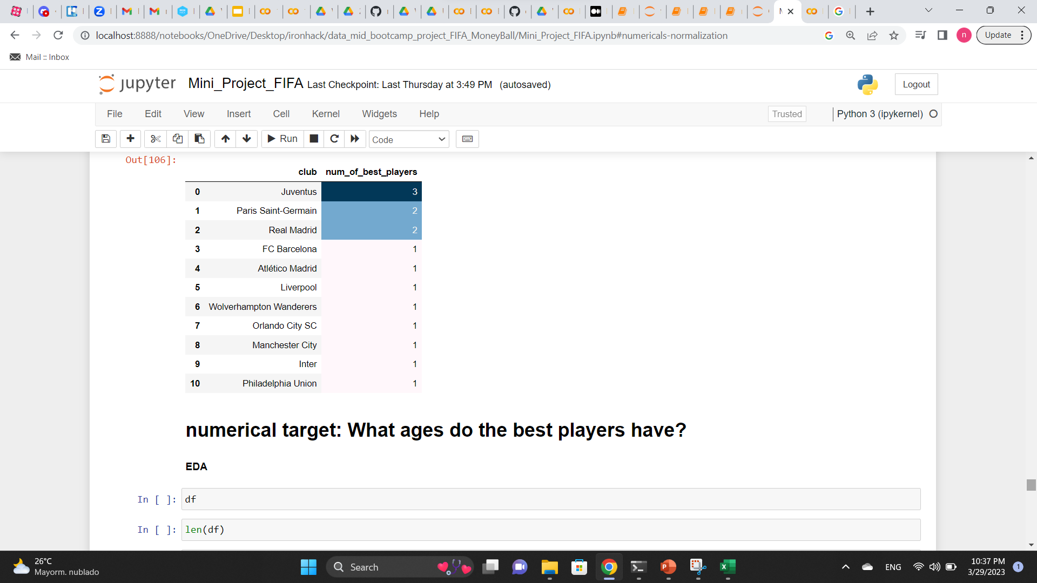
Objective 1
Objective 2
Introduction
Which club has the best and the highest number of players?
(summary)
Define the numerical target
Define the questions
Objectives
Top clubs having players with the highest number of best important traits based on the times their name appears
Standardization
EDA
Shape, correlations, plots, histograms
Dropping unnecessary columns
Read and clean the data
Methods
Dealing with null values
Processing Data
Scaling, Normalization
Answer the questions by exploring the data
Top clubs with the highest number of best players among top 20 teams
Applying linear regression
Results-
Objective 1
Predictions
Evaluating the model
11

Slide 12





Conclusions
Objective 2
Introduction
Objective 1
Which clubs have the best players?
Define the numerical target
Define the questions
Objectives
Juventus
FC Barcelona
Standardization
EDA
Shape, correlations, plots, histograms
Dropping unnecessary columns
Read and clean the data
Methods
Dealing with null values
Processing Data
Scaling, Normalization
Answer the questions by exploring the data
Which clubs have the highest number of best players (among top 20 clubs)?
Applying linear regression
Results-
Objective 1
Juventus
Paris Saint Germain
Real Madrid
Predictions
Conclusion
Evaluating the model
12

Slide 13
Conclusions
Objective 2
Introduction
Objective 1
Which clubs have the best players?
Define the numerical target
Define the questions
Objectives
Juventus
FC Barcelona
Standardization
EDA
Shape, correlations, plots, histograms
Dropping unnecessary columns
Read and clean the data
Methods
Dealing with null values
Processing Data
Scaling, Normalization
Answer the questions by exploring the data
Which clubs have the highest number of best players (among top 20 clubs)?
Applying linear regression
Results-
Objective 1
Juventus
Paris Saint Germain
Real Madrid
Predictions
Conclusion
Evaluating the model
13

Slide 14
Objective 2: What is the age of best players?

Slide 15
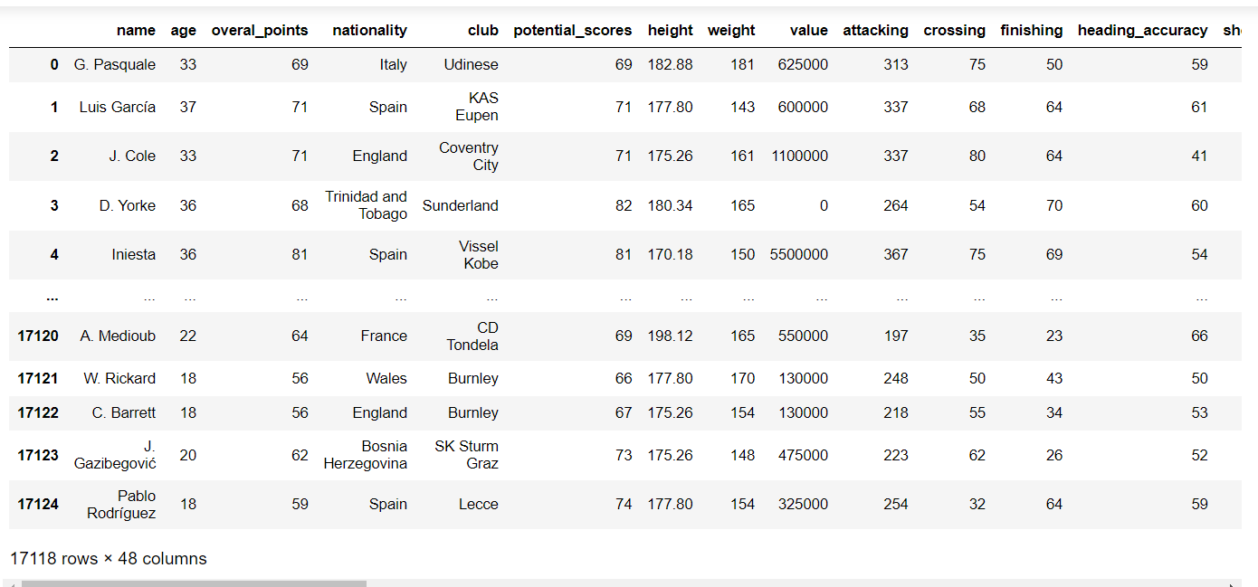
What is the age of the best players?
Objective 2
Introduction
Objective 1
Numerical target
Define the numerical target
Define the questions
Objectives
Standardization
EDA
Shape, correlations, plots, histograms
Dropping unnecessary columns
Read and clean the data
Methods
Dealing with null values
Processing Data
Scaling, Normalization
Answer the questions by exploring the data
Applying linear regression
Predictions
Evaluating the model
Dataset after cleaning with 17118 rows and 48 columns
15

Slide 16
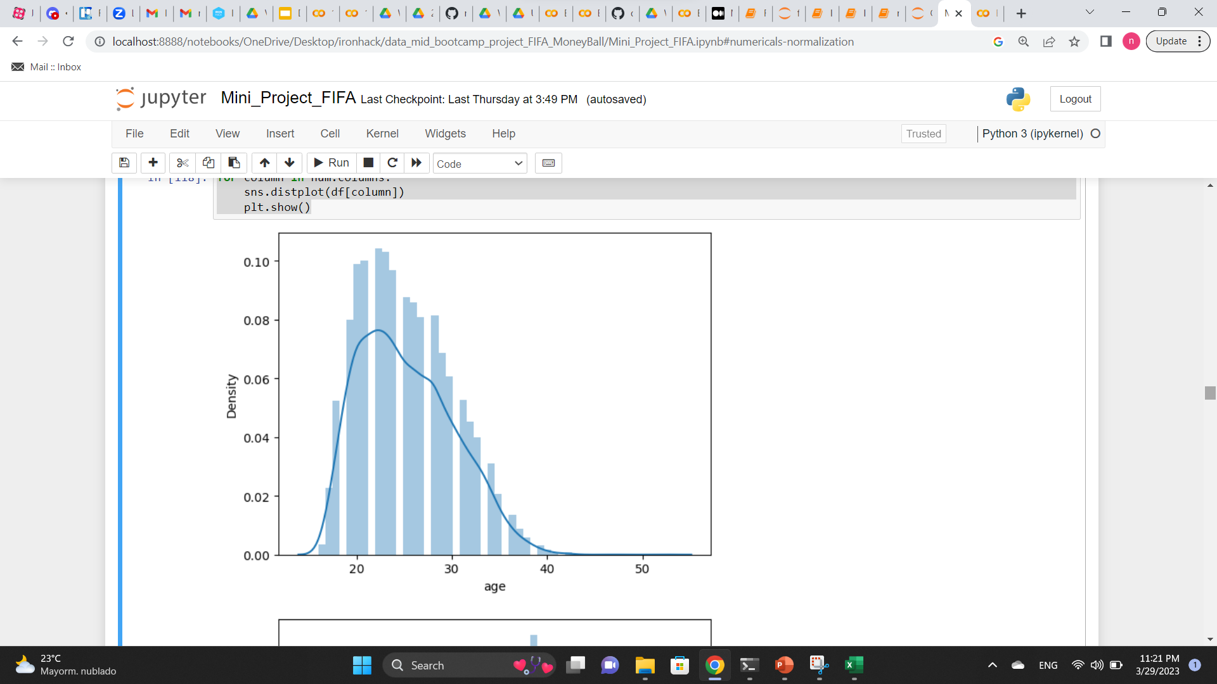
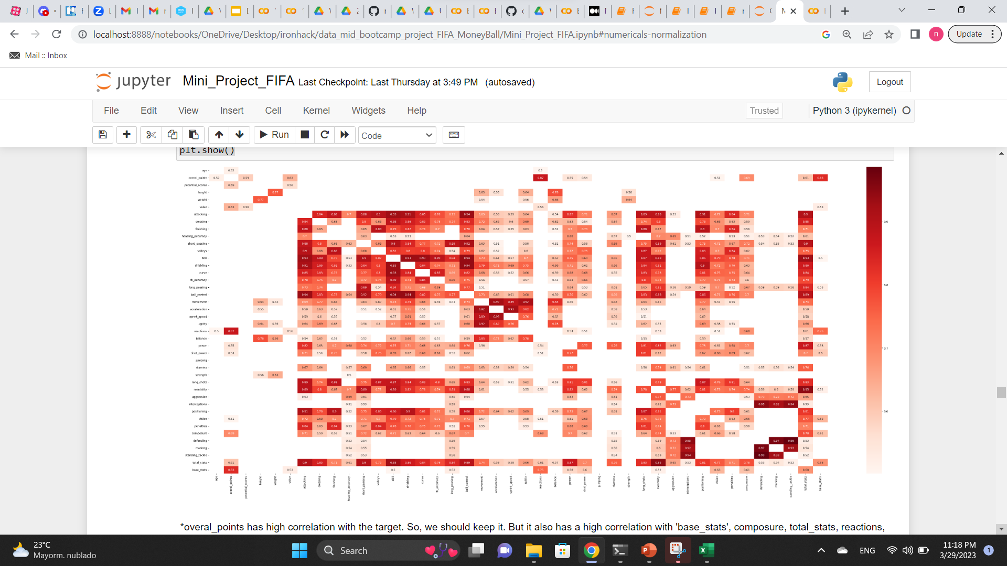
EDA
Introduction
Objective 1
Objective 2
Define the numerical target
Define the questions
Objectives
Standardization
EDA
Shape, correlations, plots, histograms
Dropping unnecessary columns
Read and clean the data
Methods
Dealing with null values
Processing Data
Scaling, Normalization
1- Check numerical columns distributions
2- Check correlations
Answer the questions by exploring the data
Applying linear regression
3- Check statistical information of the columns
4- Assess the length and shape and other information of the dataset
Predictions
Evaluating the model
16

Slide 17
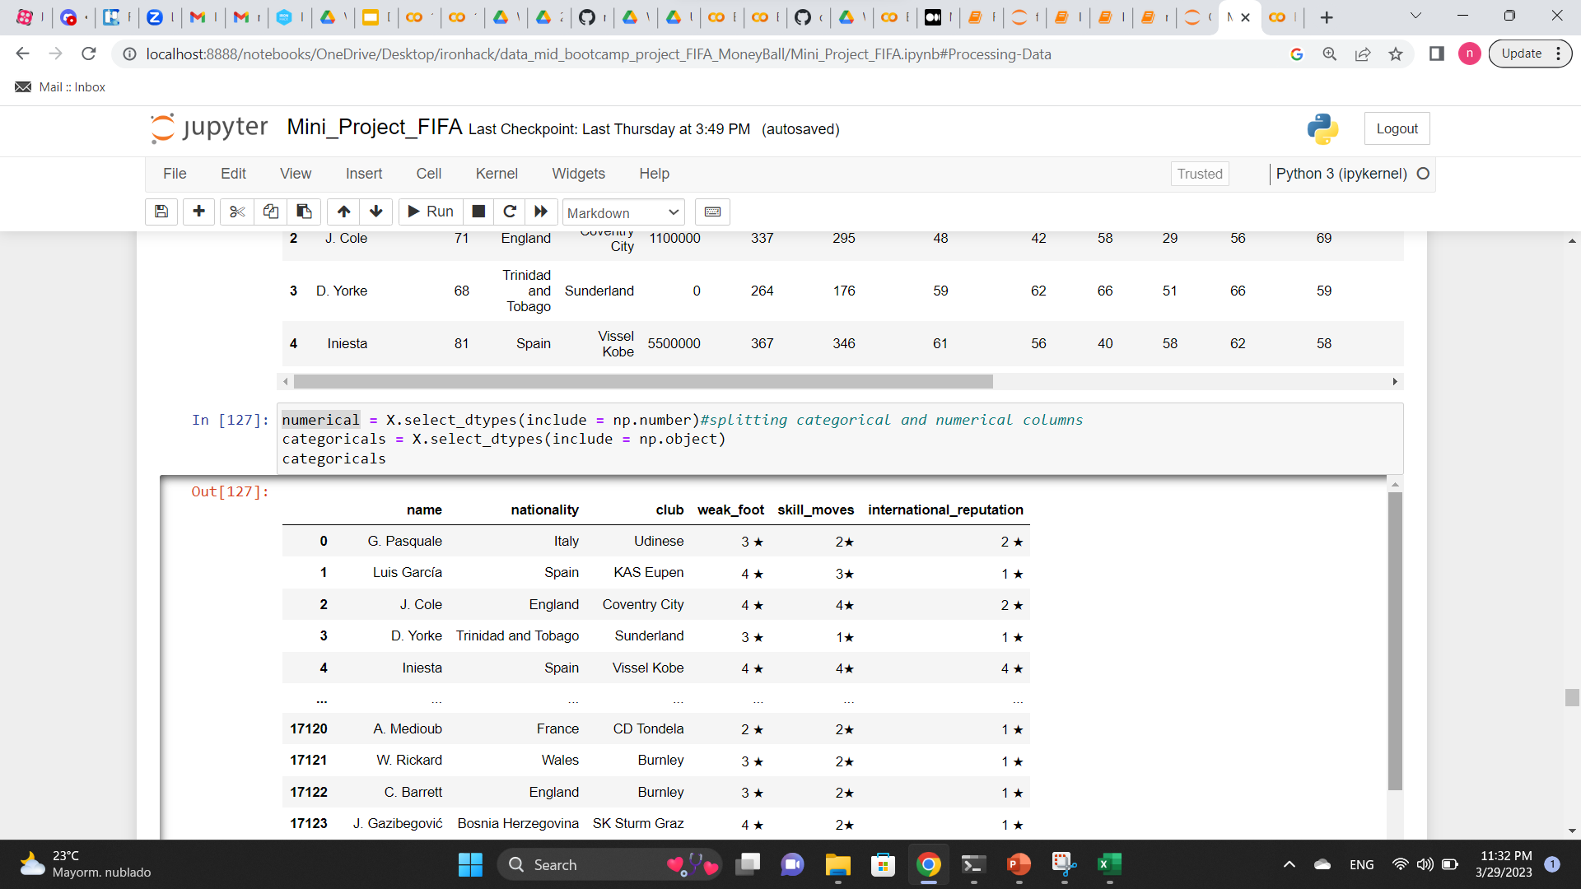
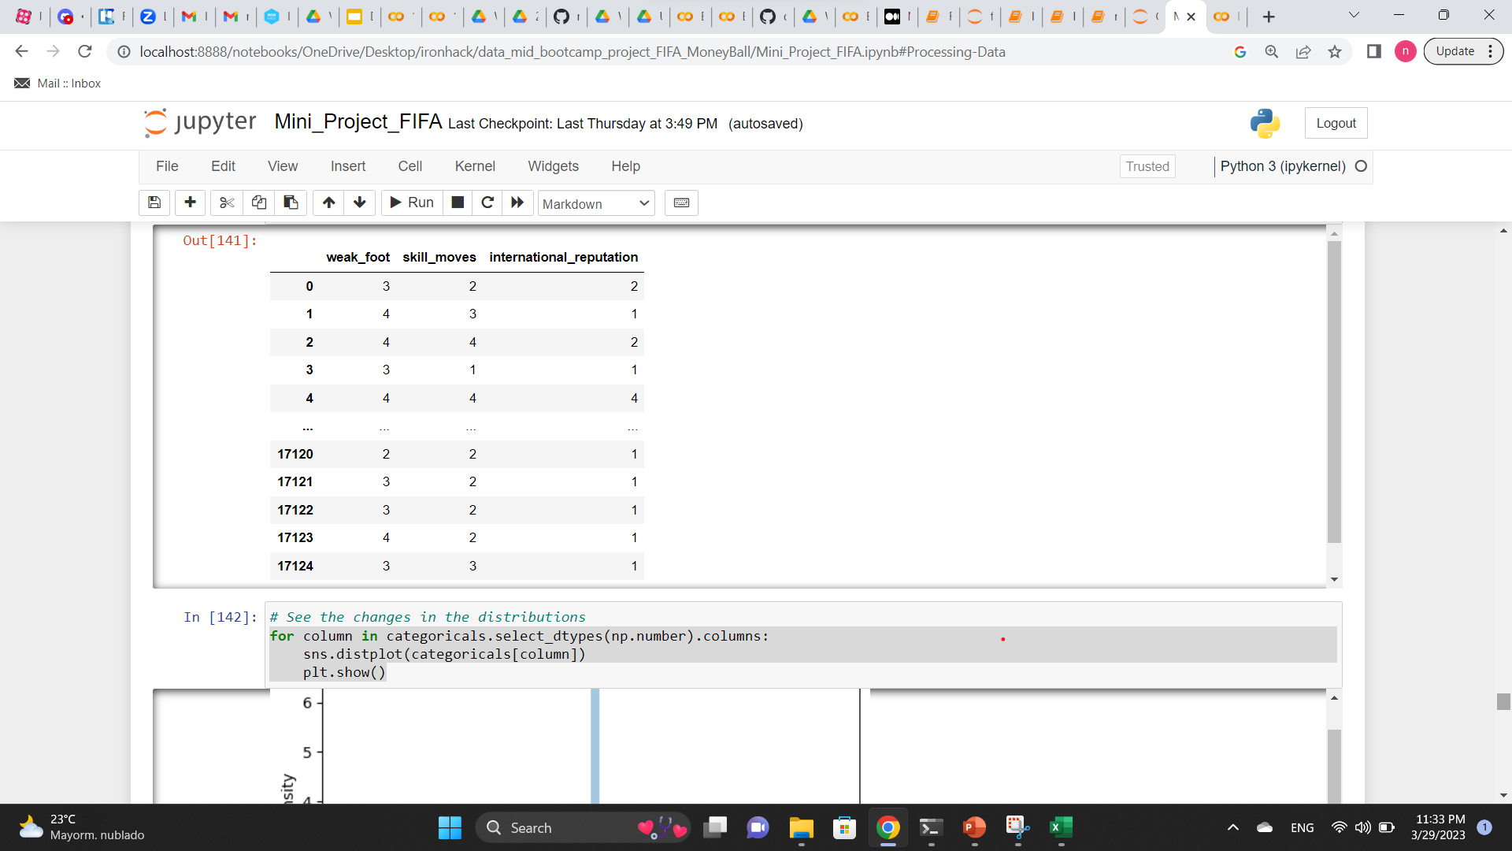
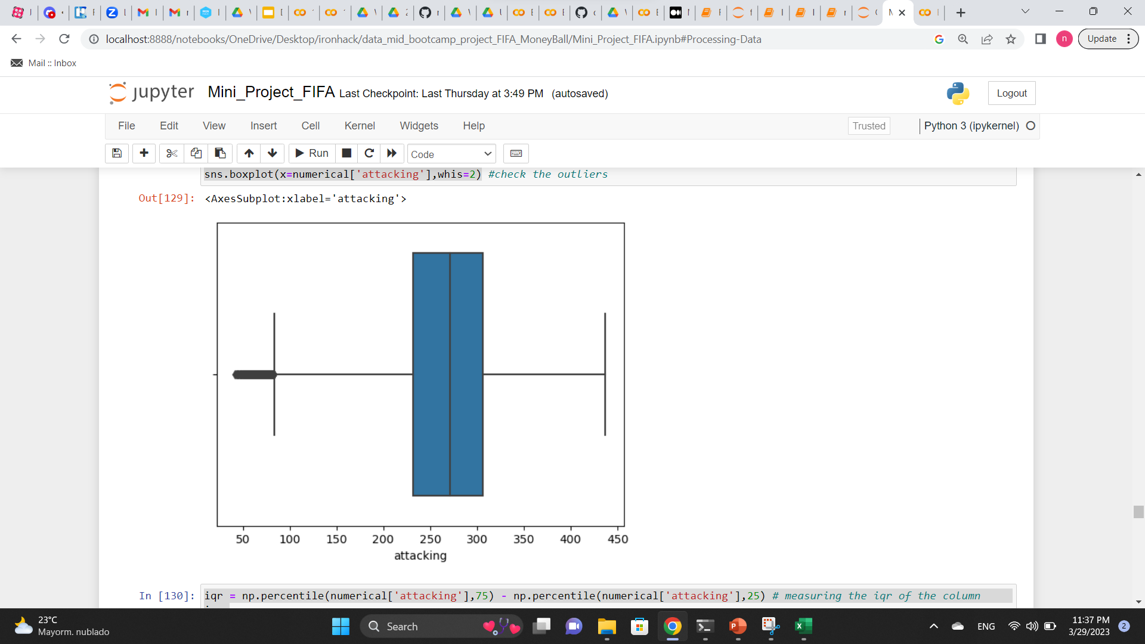
Processing Data
Introduction
Objective 1
Objective 2
1- Encoding the categorical columns
Define the numerical target
Define the questions
Objectives
Standardization
EDA
Shape, correlations, plots, histograms
Dropping unnecessary columns
Read and clean the data
Methods
Dealing with null values
Processing Data
Scaling, Normalization
2- Data normalization/scaling (Box-Cox)
Answer the questions by exploring the data
Applying linear regression
3- Removing the outliers
Predictions
4- Applying the linear regression model and get the predictions for the age
5- Evaluating the model using R2, RMSE, MSE
Evaluating the model
17

Slide 18
Processing Data
Introduction
Objective 1
Objective 2
1- Encoding the categorical columns
Define the numerical target
Define the questions
Objectives
Standardization
EDA
Shape, correlations, plots, histograms
Dropping unnecessary columns
Read and clean the data
Methods
Dealing with null values
Processing Data
Scaling, Normalization
2- Data normalization/scaling (Box-Cox)
Answer the questions by exploring the data
Applying linear regression
3- Removing the outliers
Predictions
4- Applying the linear regression model and get the predictions for the age
5- Evaluating the model using R2, RMSE, MSE
Evaluating the model
18

Slide 19
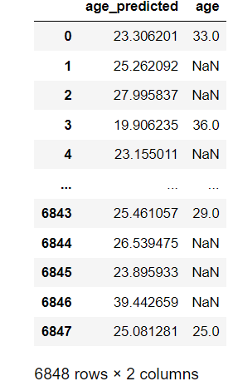
Objective 1
Objective 2
Introduction
Age Predictions
Left join the predictions and actual values
Define the numerical target
Define the questions
Objectives
Standardization
EDA
Shape, correlations, plots, histograms
Dropping unnecessary columns
Read and clean the data
Methods
Dealing with null values
Processing Data
Scaling, Normalization
Answer the questions by exploring the data
Applying linear regression
Objective 2- Results
Predictions
Evaluating the model
19

Slide 20
Objective 1
Objective 2
Introduction
Model Evaluation
R2 = 0.64
MSE = 8.65
RMSE = 2.94
Define the numerical target
Define the questions
Objectives
Standardization
EDA
Shape, correlations, plots, histograms
Dropping unnecessary columns
Read and clean the data
Methods
Dealing with null values
Processing Data
Scaling, Normalization
Answer the questions by exploring the data
Applying linear regression
Objective 2-Results
Predictions
Evaluating the model
20

Slide 21

Objective 1
Objective 2
Introduction
Conclusions
Define the numerical target
Define the questions
Objectives
1- Considering the evaluation metrics, the R2 score is good.
Standardization
EDA
Shape, correlations, plots, histograms
Dropping unnecessary columns
2- However, the MSE and RMSE results show that the model may not be reliable.
Read and clean the data
Methods
Dealing with null values
Processing Data
Suggestions
Scaling, Normalization
Answer the questions by exploring the data
Applying linear regression
Objective 2-Results
1- Include more columns for the prediction
2- Double check the cleaning process and correlations
Predictions
Conclusion
Evaluating the model
21

Slide 22

Thanks for your attention

